Slide 1

BIRRWISE
A Personal Finance Tracker website
Meklit Sisay
Prepared by:
Rahel Melaku
Yonatan Lisanu
October 2025

Slide 2

Table of Contents
1
4
7
Problem
Target Users
Future Improvements
2
5
8
Project overview
Features
Challenges & progress faced
9
3
6
Conclusion
Objectives
Tech Stack

Slide 3

Problem
1
Individuals struggle to track & manage their money.
Traditional methods are time consuming and hard to update.
2
Limited financial literacy & lack of informed decisions
3
3

Slide 4

Project Overview
BirrWise- Personal Finance Tracker
Simple, intuitive, and organized system
Record transactions, categorize expenses, and generate clear financial reports
Helps users understand their spending habits, track progress, and make informed financial decisions.
4

Slide 5

Objectives
Building a platform for managing money
Building user-friendly & interactive finance tracker
5

Slide 6




Target Users
University Students
Young Professionals
Micro-Entrepreneurs
Household
6

Slide 7


Features
User authenthication
Quick add buttons
Customizable categories
Financial reports
7

Slide 8



Tech Stack
Mongodb
Node.js
Tailwind CSS
Express
8

Slide 9



Future Improvements
Monthly / Weekly budget planning & saving goals
Artificial Intelligence integration
Financial reminder for payments and other bills
9

Slide 10
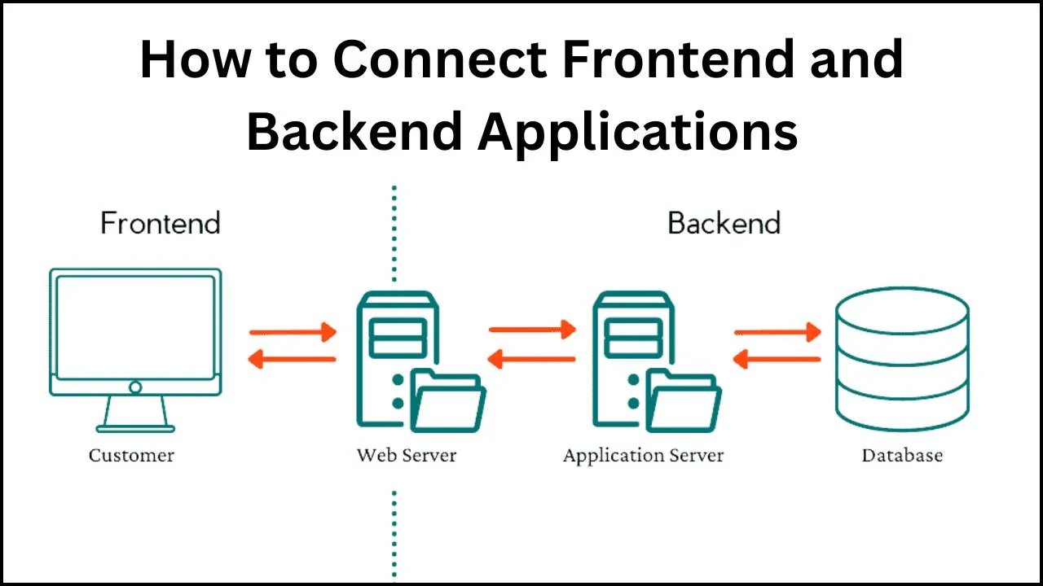

Challenges & progress
Frontend development
Backend development
GitHub Repository
9

Slide 11

Conclusions
Thankyou for your support and this opportunity
During this summer camp, we got many things.
Team work, self-development …
We, as a team, have a strong desire to finish this project and make it functional!
9

Slide 12
<Thank You!/>
Contact Us:
meklitsisay18@gmail.com
10

Slide 13
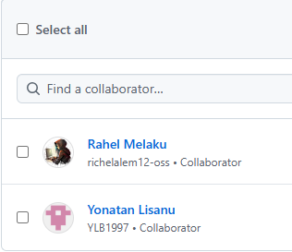
Backend development
Challenge faced in API and backend integration
Due to that, can’t able to integrate with frontend
9

